Slide 1
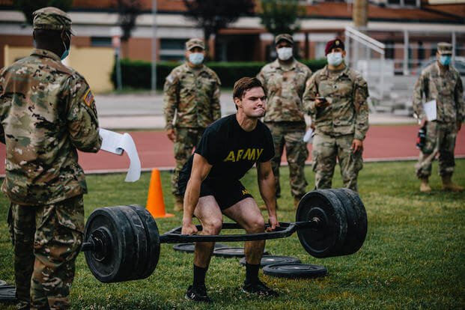
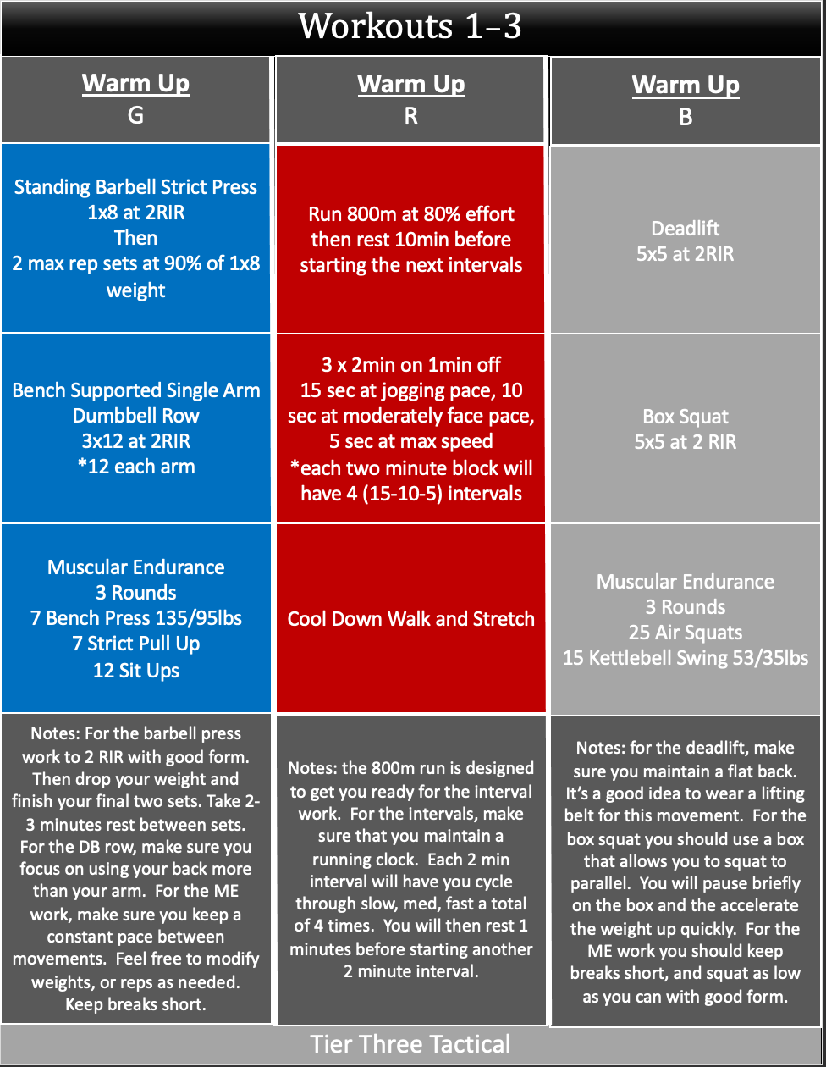
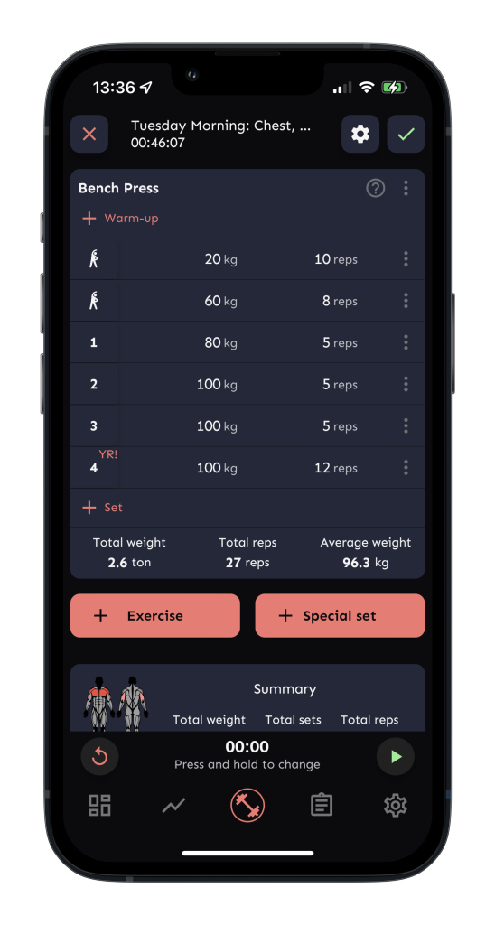

CTAF
Home
About
Feature
Contact
Help
Get Started
Combat Tactical Athlete Fitness
Tactical Training, Human Performance, Training Tracker, Hybrid Training Programs.
Accomplish your mission with fitness and performance.
About Us
As a member of tactical population, maintaining the skills, strength, and overall fitness to overcome tough obstacles is one of the embedded task that servicemembers face everyday. With reinforcing form an external support, CTAF is a solution for average joes that would like to create tactical training programs that will tailor within their occupation, physical level or personal fitness goal.
Feature
What is CTAF?
Tacthelete is a developing app that assist service members to prepare, build, and maintain their physical fitness from build-in to customizable training programs.
Programs
Progress Tracking
Fitness Planner
- Mobility Training
- Home Training
- Strength Training
- Selection Prep
- Squad Workout
- Reps and Sets
- Percentages and RPE
- Timer
- Notes
- Exercise Demos
- Custom Workout Program
- Record Exercises
- Analyze Training
- Create a group program
Contact Us
Any Questions?
📞 Phone:
123-456-7890
📍 Location:
312 Blank St, Hawaii
✉️ Email: contact@tacthelte.com
Name
Email
Message
Send us a message
Submit
Let’s Start The Training
Create an Account

Slide 2
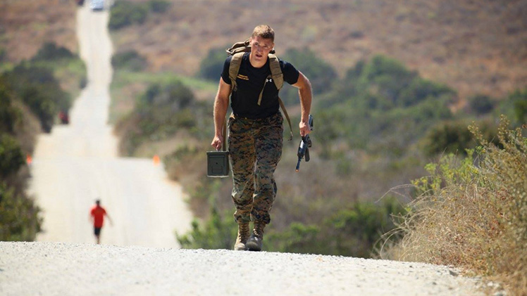
CTAF
Home
About
Feature
Contact
Help
Get Started
Combat Tactical Athlete Fitness
About Us
As a member of tactical population, maintaining the skills, strength, and overall fitness to overcome tough obstacles is one of the embedded task that servicemembers face everyday. With reinforcing form an external support, Tacthlete is a solution for average joes that would like to create tactical training programs that will tailor within their occupation, physical level or personal fitness goal.
Mission
Our mission is to fully support out servicemember and veterans to achieve their fitness goals by providing the tools they will need to their journey.

Slide 3

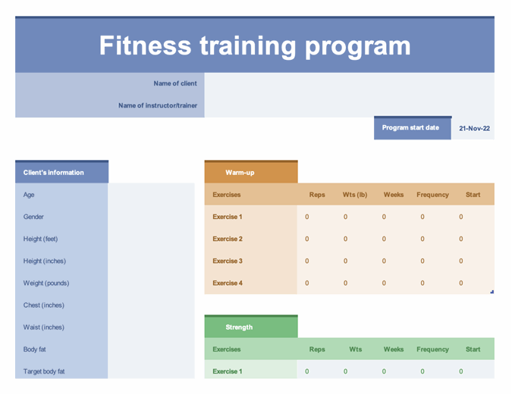
CTAF
Home
About
Feature
Contact
Help
Get Started
Combat Tactical Athlete Fitness
Tactical Training, Human Performance, Training Tracker, Hybrid Training Programs.
Accomplish your mission with fitness and performance.
Feature 1
Programs Available
Mobility Training
Home Training
Strength Training
Selection Prep
Fire Team / Squad Workout
Feature 2
Progress Tracking
Reps and Sets
Percentages and RPE
Timer
Notes
Exercise Demos
Feature 3
Fitness Planner
Custom Workout Program
Record Exercises
Analyze Training
Create a group program

Slide 4
CTAF
Home
About
Feature
Contact
Help
Get Started
Combat Tactical Athlete Fitness
Contact Us
Any Questions?
Name
Email
Message
Send us a message
Submit
📞 Phone:
123-456-7890
📍 Location:
312 Blank St, Hawaii
✉️ Email: contact@tacthelte.com

Slide 5
CTAF
Home
About
Feature
Contact
Help
Get Started
Combat Tactical Athlete Fitness
Help – User Manual
Tech Support
How can we help?
Submit a request
Submit

Slide 6
CTAF
Home
About
Feature
Contact
Get Started
Combat Tactical Athlete Fitness
Get Started
14 – DAY FREE TRIAL
Name
Email
Age
Gender
Height
Weight
Occupation
Activity Level
Any injuries or health conditions?
What is your goal?
Create Account

